Slide 1
From
S&T led Agricultural Production to
Agricultural Innovation Systems
INDIALICS Training Programme
CDS, Trivandum

Slide 2
Agriculture in India- an overview
Profile | 2009-10 | 2010-11 | 2011-12 | 2012-13 | 2013-14
GDP at factor cost (2004-05 prices) (Rs. Crores) Growth Rate (%) | 4516071 8.6 | 4918533 8.9 | 5247530 6.7 | 5482111 4.5 | 5741791 4.7
Agriculture Share in total GDP (%) Growth rate (%) | 14.6 0.8 | 14.6 8.6 | 14.4 5 | 13.9 1.4 | 13.5 4.7
Agriculture Share in Agricultural GDP (%) Food grains (Million tonnes) | 12.3 218.1 | 12.4 244.5 | 12.3 259.3 | 11.8 257.1 | n.a. 264.4
Agriculture Share in total GCF (%) Share of Agriculture in Agricultural GCF (%) | 7.3 6.7 | 6.3 5.8 | 7.0 6.5 | 7.1 6.5 | n.a. n.a.
Agricultural GCF as a % of Agricultural GDP (%) Share of private sector (%) | 20.1 16.7 | 18.5 15.7 | 20.8 18.0 | 212 18.1 | n.a. n.a.
Agricultural exports including marine products as percent of total exports (%) | 8.2 | 8.0 | 10.1 | 11.8 | 11.9

Slide 3
Why “innovation” for inclusive development?
When we have -
Re-distribution – with increased expenditure or flagship programmes for the poor
Public sector mandates to target rural areas and backward regions, population groups, etc.
New private and public-private partnerships and investments in – services, extractive and manufacturing industry, agriculture
Attempts to enable and promote pro-poor knowledge and technology generation …..Others…
Why “Innovation”? Because “Inclusion” is Historically Conditioned, Socially Embedded and Politically.-Economically Linked …

Slide 4
Can ‘Innovation Systems’ deliver inclusive development?
Three major pitfalls in Innovation Systems research ..
1. Technological - AND - Institutional Innovation
2. Sources of Innovation – S&T led vs. multiple socially embedded
3. Pathways and Models - linear reasonably uniform vs non-linear evolutionary (CCC)
Inability to handle emerging problems…

Slide 5
Institutions Matter
-climate change, financialisation problems, ownership and distribution of knowledge, gender, violence, prosperity without growth…
Any institution- stabilized forms of behaviour or habits of thought are axiomatically outdated (Veblen)
Institutional economics or “the study of the changing patterns of cultural relations which deal with the creation and disposal of scarce material goods and services by individuals and groups in the light
of their private and public aims” (Kapp, 1968, p.2)- is crucial to understand “how” innovation takes place and is governed.
Institutions, “the ‘deep’ determinants of development”, the variables and processes that “shape the proximate determinants of growth: factor accumulation, technology adoption and policy choices,” (Adam and Dercon, 2009, p. 174; Rodrik et al, 2004; Nelson, 2008; Commission on Growth and Development, 2008), need deeper analysis and explanation of causal relationships.
In economics we need to bring back Veblen, Ayers, Commons, Kaldor, Myrdal, Kapp, Hettne, Schumpeter…and many others. To work out “how” innovation systems can be made inclusive –to work with Freeman, Nelson, Lundvall, Edquist, ..

Slide 6
Illustration- Institutions, capital and their mutual relationships in a NIS
(Raina, 2015- Adapted from Table 1.2. in Lundvall et al, 2009, p.18).
Institutions or norms govern diverse capital
 | Easier to produce, Reproduce or use | Not easy to produce or reproduce
Tangible resources | Production capital | Natural capital
Intangible resources | Knowledge capital | Social capital

Slide 7
Institutions:
Peaceful co-existence? Or irrefutable analytical basis?
NSI- Freeman (1987) + contributions from Nelson (1993) and Lundvall (1992)
Two different (yet overlapping) innovation systems discourses
Nelson (1993) -legacy of development economics - organized scientific knowledge is a major driver of innovation; focus on S&T based, national empirical evidence of innovation. In the second (Lundvall, 1992), the thematic discourse is about interactions and
Lundvall (1992)- drawing upon the social construction of technology or actor-network theories - learning, cumulative knowledge, structural and functional capabilities; Seeks inter-disciplinary explanations of innovation with credence to institutions or the rules and norms that govern the actors.
The narrow (S&T based) and broad (interaction and learning based) approaches to NSI have however, not confronted each other. They enjoy a ‘peaceful co-existence’ (Edquist and Hommen, 2008)
Few attempts to bridge or reconcile their differences.
A reconciliation between these two approaches is important, given the overarching institutions or norms of development that govern both S&T actors and the development sectors (agriculture and industry)critical to rural poverty.

Slide 8
Institutions matter – in agriculture
Norms of public policy – development legitimizations, contents and designs of schemes,
Institutions of production – tenancy, access to resources, knowledge services, production inputs/services,
Norms of valuation – of resources (land and water, and energy- labour, mechanical), outputs, gender relationships, caste,
Regulations – linked markets, standards, quality, safety, …

Slide 9
S&T led Agricultural Production
Agricultural production programmes – Irrigation, DoAC, DoAH, IFPRI, State Departments,
S&T application in programmes – ICAR – CRIDA/ CAZRI, SAUs, ICRISAT, ICARDA,
Intermediary agencies – NABARD, Irrigation departments, APMC, PACS, ..
Industry for input supply – Chemicals - FAI, Syngenta, Mahyco- Monsanto,
Famers associations – BKU, …..(demanding MSP, subsidies, concerns about labour, mechanization,)

Slide 10
But knowledge (S&T) and policy are part a larger institutional framework - the ‘Supply Syndrome’
During 1990-2009 agricultural R&D received less than 0.4 % of the Agrl GDP
Input subsidies alone – 8-11 % of agricultural GDP
Input subsidies account for 88 % of the total plan outlay of agriculture, irrigation and rural development (Vaidyanathan, 2010)
Fertilizer subsidy 2012-13 - Rs. 90,000 crores
Significant decline or stagnation in incremental response to input use (irrigation and chemical fertilizers – Vaidyanathan, 2010), and growth rates of rice-wheat production (ibid, Bhalla and Singh, 2010)

Slide 11
Norms of Supply
Convergence of Policy, Practice, Knowledge
Over the past four decades….
From multiple crop/crop-livestock/livestock research
to cereal based monoculture research
From provincial research stations to centralized Council
From higher education for rural development to specialised agricultural universities
From community development programmes to sub-sector specific extension services, technologies, inputs & subsidies
From local markets to levied (MSP) stocks for FCI –PDS- global trade
From local inputs /services to industrial inputs- chemical, mechanical, financial, biological inputs from industry
From rainfall and locally managed irrigation to large dams

Slide 12
Disenchantment with an incorrigible S&T….
It is necessary to take a comprehensive view of the functioning of the agricultural research system and make systemic changes in the course of the Eleventh Plan. Thus far, research has tended to focus mostly on increasing the yield potential by more intensive use of water and biochemical inputs. Far too little attention has been given to the long-term environmental impact or on methods and practices for the efficient use of these inputs for sustainable agriculture. These features are widely known but efforts to correct them have not been adequate; at any rate they have not made much of a difference (Government of India, 2008, Vol. 3, pg. 13).

Slide 13
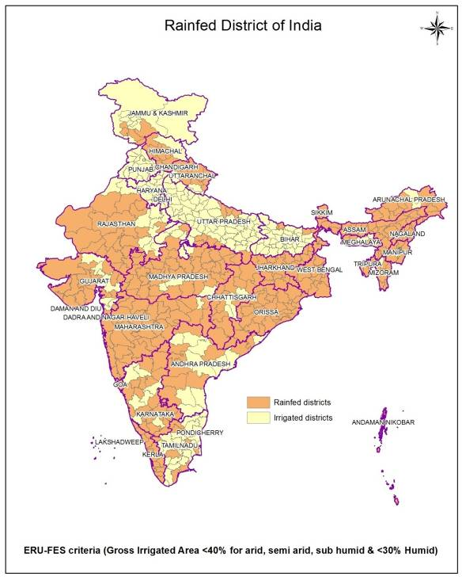
…More than half of arable land is rainfed
61% of net sown area is rainfed
84% of rural poor reside in rainfed areas
The BIG 5 – farmers suicides
34 predominant crops
Over 80 % of the pulses, horticultural, livestock products….

Slide 14
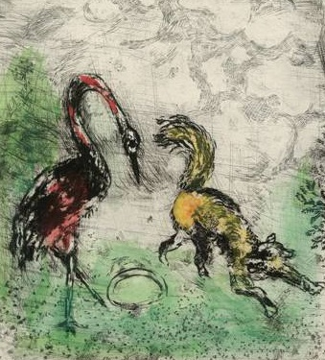

The Story of Rainfed Areas!!
What is the relevant framework for development of rainfed areas?
22-08-2013
ResRA- RRA Network
Notes:
14

Slide 15
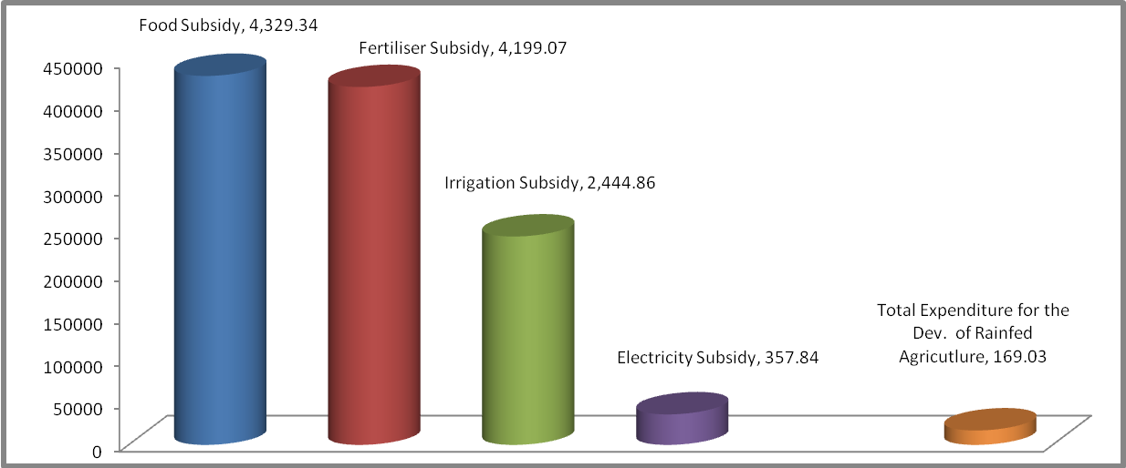
Lopsided Public investments
(1997-98 to 2011-12) rainfed agriculture vs. irrigated agriculture (Source: estimated by CBGA, RRA Network)
Notes:
15

Slide 16
The Paradigm Shift
Conventional/Mainstream
Strategies/ programs conceptualized at the top- technologies generated - prescribed
Extension systems
Schemes designed for implementation
Modern Systemic/ RRA
S&T capacities developed in the Blocks
Local problems-local solutions -iterative -technological learning
Location specific strategies identified and programs evolved
22-08-2013
ResRA- RRA Network

Slide 17
The RRA network is attempting to evolve a framework and advocates for…
Differentiated Policies for rainfed agriculture (including livestock and fisheries)
Substantial scaling up of public investments for revitalising rainfed areas
Appropriate Framework for public investments
Appropriate Institutional Systems
Notes:
17

Slide 18
The dominant discourse – neglect of rainfed areas
Policy problem – low yield or productivity
Assumptions
– that investments in irrigated agriculture is extendable to rainfed areas
that technology and inputs can be supplied – from S&T to line departments to farmers
that the diversity and variability of rainfed farming systems can be handled by the supply-driven system
Policy actors – S&T led and politically legitimized – schemes- food security
RRA articulation of high potential for sustainable, equitable development…(the example of Bt MECH hybrids)

Slide 19
…in a context of minimal Policy engagements in agriculture, not to speak of rainfed ….
In India –Policy documents
For Agriculture (2000), Farmers (2007)
For Industry – Bombay Plan (1948), IDR Act (1951), Industrial policy resolution (1956) (1964,1969, 1970), Industrial Policy Statement (1973, 1977, 1980, 1991, 2004, 2006), National Manufacturing Policy – expected soon
For Science (1958), Technology (1983), Science & Technology (2003)
Notes:
19

Slide 20
Recall the convergence –
Centralisation of Agricultural S&T
Year | Total Central Government | State Governments and UTs | Total NARE
1960-61 | 56.27 | 86.77 | 143.04
1970-71 | 261.98 | 187.53 | 449.51
1980-81 | 470.65 | 239.63 | 710.28
1990-91 | 784.67 | 327.05 | 1111.72
2000-01 | 1443.95 | 512.55 | 1956.50
2009-10 | 2302.40 | 765.95 | 3068.35

Slide 21
....was not always the case...
Year | Ratio Central :State Govts
1960-61 | 39:61
1965-66 | 26:74
1974-75 | 59:41
1979-80 | 67:33
1990-91 | 71:29
1997-98 | 71:29
2006-07 | 75:25
2009-10 | 75:25

Slide 22
Phases of Agricultural S&T in India
Important Phases | Year | CAGR
Centre
Pre- consolidation | 1960-61 to 1965-66 | -1.96
Pre- department (DARE) status | 1966-67 to 1974-75 | 9.53
Centralized Consolidated Expansion phase | 1975-76 to 1996-97 | 7.49
Centralized Consolidated phase | 1997-98 to 2009-10 | 8.15
States
Pre- Model Act & SAUs | 1960-61 to 1969-70 | 7.69
Pre- NAAC & SAUs+ AICRP Phase | 1970-71 to 1989-90 | 2.41
Centralization phase | 1990-91 to 2009-10 | 4.58

Slide 23
The S&T led Agricultural Production System contradicts the Constitution..
‘Agriculture, including Agricultural Extension and Research, Protection against Pests and Prevention of Plant Diseases” is a State subject (see Entry 14 of List II- State List in the VII Schedule of the Constitution of India).
+ Distorts the Science-Policy relationship.....
+ Distorts all effective linkages and interactions between the Natural, Social and Physical capital

Slide 24
An agricultural innovation system – with pro-active linkages designed for each Block
(Raina, 2015- Adapted from Table 1.2. in Lundvall et al, 2009, p.18).
Institutions or norms govern diverse capital
 | Easier to produce, Reproduce or use | Not easy to produce or reproduce
Tangible resources | Production capital | Natural capital
Intangible resources | Knowledge capital | Social capital

