Slide 1
Studying transformation, transition and conflicting objectives
Innovation studies and SDG
Olav Wicken

Slide 2
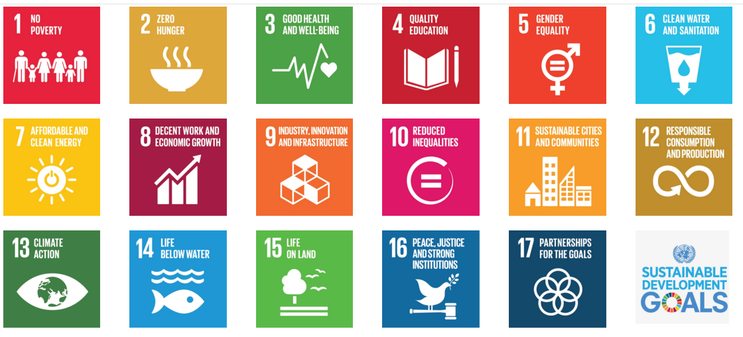
Sustainability Development Goals – social & environment
Notes:
Many goals, incl some economic bus mainly social & environmetal
Directly economic: decent work & economic growth, responsible consumption and production – Growth not independent goal!
Growth 1991-2008 did not improve the development.
See economy as an instrument for social wellfare, wellbeing and susainable natural enironment?
- Innovation has traditionally focused mainly on economic development

Slide 3
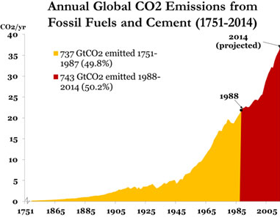
Direction of development
Combination of economic growth/boom (1991-2008) and increasing social and enviromental problems (reflected in SDG)
  Climate emissions increasing
  Water supply global problem
  Life below water deeply troubled
  Inequality increasing
  Consumption not responsible
  Clean energy slowly developing
  Demand for sustainable cities
Notes:
SDG sys: todays development is not sustainable. We need to change direction of development
How do economies and societies change developmet path?

Slide 4
SDG - emerging Grand challenges
Grand challenges: Concept increasingly used in policy doc
Challenging for social sciences research to respond
  Not fit into existing disciplines (need-cross disciplinarity)
  No clear end-situation defined: open ended issue
  Processes with uncertainty and risk
  Contested goals and how to reach them
Academic community engaged in creating analytical tools for analysing processes relevant for Grand challenges

Slide 5
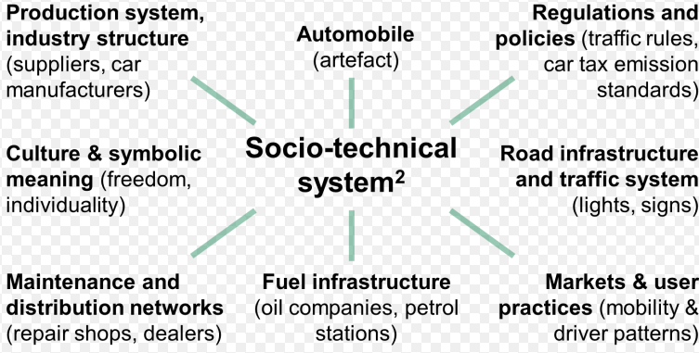
Analysing Grand challenges: transition studies
Closely liked to innovation studies
Transforming old socio-technical systems /regimes and creating new
  From path dependency to path creation
Empirical studies mainly related to climate and energy
  i.e. transforming fossil energy
  regime & creating renewable
  energy systems
Notes:
Path creation – esablish he beginning of a new path

Slide 6
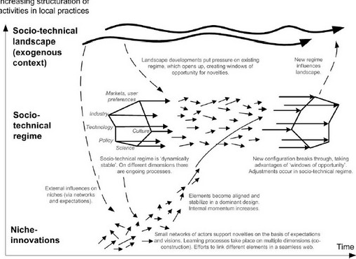
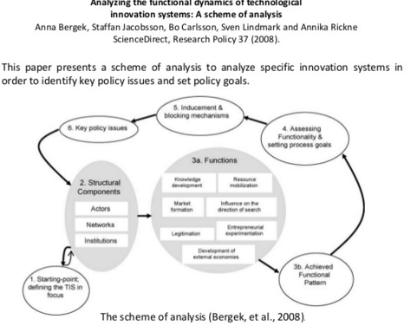
Approaches to analyse innovation system transformation

Slide 7
The main task: dismantling old & creating new IS
Socio-technical & innovation systems not in line with SDG must be dismantled
  How will this take place as strong resources involved & policy support?
  Conflicts! Mot difficult – how does this happen?
New systems in line with SDG must be built
  How to build when limited resources, knowledge bases and institutions supporting the new?
Is this a window of opportunity for economies without strong «old» innovation systems?

Slide 8
Transition studies - dynamic field of research
Atracts young scholars engaged with societal challenges
Dynamic and creative
  Vitalisation of innovation system approaches (TIS)
Interesting network for young innovation researchers
Position innovation systems studies as a central approach for analysing challenges underlying SDG
Transition studies: STRN Sustainable TRansition Network

