Slide 1

Exploring local systems of innovation and production
Training Programme on Research Issues and Methods in
Innovation Systems and Sustainable Development
Trivandrum, 14-20 March 2016
CDS
Helena M M Lastres
hlastres@bndes.gov.br
Office for Local Innovation and Production Systems and Regional Development
SAR/BNDES
l

Slide 2
Five main policy implications deriving
from the knowledge accumulated
about innovation, innovation systems,
LICSs and LIPSs in the 3 last decades
(Lastres et at., 2016)

Slide 3
Policies for innovation: how to advance
1 – Differentiation between Invention from Innovation
Main characteristcs of usual indicators for science, technology and innovation for measuring performance and guiding policy - Patents, publications and R&D activities
Revision of policy emphasis
  from the support of infrastructure, R&D activities and intellectual property – big corporations
  to the effective mobilization of means to acquire, use and accumulate knowledge in a vast array of activities
Need to develop and use new indicators
3

Slide 4
Policies for innovation: how to advance
2 – Differentiation between Knowledge from Information
Acquisition of knowledge, equipment and technology developed abroad can never replace the need to create and foster local and national capacity-building opportunities
Selection, purchase, copying, incorporation and use require considerable capacity
A crucial learning dimension relates to the capacity of putting into practice the knowledge and technologies acquired
the capacity to generate and internalize new knowledge depends directly on use
Revision of policy emphasis
  from technology imports
  to fostering the creation of absorptive capabilities and the promotion of solid, interactive and dynamic local and national production structures
12

Slide 5
Policies for innovation: how to advance
3 - The production and innovation capacity of a country or region reflects historical, territorial, political, economic and socio-cultural conditions
Different contexts – with particular cognitive and regulatory systems and means for articulation and learning - lead to
different ways of generating, assimilating, using and accumulating knowledge, and to
specific policy requirements
Revision of policy emphasis
from comparing with MDC’s performance, copying MDC’s policy agenda and aiming to "catch up"
to developing and using proper and contextualized concepts, indicators, methodologies and policy models
5

Slide 6
Policies for innovation: how to advance
Contextualization of analytical and policy frameworks
Type of insertion of a country or region within the wider geopolitical context and the role of:
  implicit policies (Herrera, 1971) and
  malign macroeconomic regimes (Coutinho, 2003)
Need to address strategic development priorities
  Joseph, 2012
  Innovation policies can and should contribute to reduce regional and social inequalities and exclusion
Opportunities to incorporate social inclusion and sustainable development in research and policy agendas
Revision of policy emphasis
  from imitating and imposing exogenous models
  to implementing adequate policies, capable of stimulating the formulation of contextualized solutions for development from the micro to the macro level
6

Slide 7
Policies for innovation: how to advance
4 - Production and innovation dynamics strongly
relates to capacities in the production of raw materials, equipments, final goods and services and commercialization segments, besides involving a series of other activities and organizations that are responsible for
  their promotion, regulation, financing and representation
  assimilating, using and disseminating knowledge and capabilities
depends on their economic, political and social agents and on their environment
Development of the concepts of NSI - national systems of innovation (Freeman, 1982 and 1987; Lundvall, 1985) and LIPSs - local innovation and production systems (Cassiolato and Lastres, 1997)
15

Slide 8
Policies for innovation: how to advance
Main policy implications (Scerri and Lastres, 2013)
A - Focus on the different production and innovation systems as well as their territories, instead of individual and isolated support to firms and projects
Policies capable of:
fostering articulations and synergies among actors performing different functions within one or more LIPSs
stimulating their capacity of generating, assimilating, using, accumulating and diffusing knowledge
8

Slide 9
Policies for innovation: how to advance
B - Importance of
de-mystifying the supposed antagonism of economic, political, regional and social development goals, and of
associating the different inseparable dimensions of development
Policies capable of:
breaking invisibilities and exclusions
  informal actors and activities
  gender, racial and other power imbalances (Joseph, 2012)
focusing on and promoting inclusive, cohesive and sustained development
9

Slide 10
Policies for innovation: how to advance
5 - Production and innovation efforts are not limited to economic development nor to the activities of particular companies, sectors and regions
‘Narrow definitions of the national innovation system are of limited relevance … (and) misleading when it comes to inform innovation policy strategy everywhere.’ (Lundvall et al., 2011)
Policies fostering production and innovation systems for the provision of food, health, education, housing (with sanitation and access to water and electricity), culture, waste treatment and other essential public services
10

Slide 11
Policies for innovation: how to advance
  Existing experiences reveal important lessons of inclusive, systemic and sustainable development. Eg: education LIPSs in the Amazon
Example: education system usually involves:
  means of transport: buses, bikes, boats, etc.
  buildings and other facilities: furniture
  information and communication technologies and systems
  food and beverage: eg new law in Brazil granting that 35% of the school meals is provided by family agriculture
  clothing and shoes
  services, etc.
  The role of teaching and research efforts in revealing and exploring these opportunities. Eg.case studies on health LIPSs in Brazil, India, South Africa, China and Uruguay
11

Slide 12
Innovation and Production Systems:
limitations in the use of the approach
Limited and outdated notion of innovation & system and of its analytical and policy backgrounds
confusion between knowledge and information, technology and equipment and between transference and acquisition of technologies
bias towards radical innovations occurring only in high-tech sectors, as a result of R&D performed by big firms in MDCs, correlation with patents
dissociation of innovation to the promotion of local development and social inclusion
use of ISs and local innovation and production systems (LIPSs) as a synonyms for industrial districts, sectoral clusters, chains, networks… at research and policy-making spheres
12

Slide 13
Innovation and Production Systems: limitations in the use of the approach
Is catch-up good enough to replace development in research and policy agendas?
  Is the idea of countries catching-up with the most advanced countries real and desirable? (Arocena and Sutz, 2012)
  Development implies a qualitative transformation and should not be conceived as merely following and catching-up with the leading countries, even if this was possible. Each country’s historical experience is a unique process and differs from any other (Cassiolato et al, 2005)
Is the IS framework compatible with the supposition that there exist ideal models to be followed by all?
What are de advantages in developing and using typologies to classify the different ‘stages’ of a IS: E. G.: dynamic, potential, incipient, stagnating, mature, world class, etc.?
13

Slide 14
Models and taxonomies on LICSs
To what extent
most of the LICSs analytical and policy frameworks in use
  are not static?
  do not remain limited by a narrow horizontal sectoral focus?
  do not ignore local contexts, geopolitics and power conflicts?
  are indeed capable of capturing the specificities of real production and innovation structures?
do not escape the criticism of representing
  only a new icing on very traditional forms of policy-making? (Reinert and Reinert, 2003)
  a truly Procustean Bed? (Lastres and Cassiolato, 2004; Arroio, 2012)
14

Slide 15
Reductionism can lead to serious negative consequences
in the analytical dimension, a failure to perceive and understand local and national conditions, which remain invisible and excluded ("below the radar") both from the research and policy agenda
in the policy dimension, a trend to submit local conditions to inappropriate models and to blame/punish them not to conform to these models
Despite the advances in the understanding of innovation in the last 3 decades – after the development of concept of IS – most frameworks, models, taxonomies have not been entirely capable of assimilating some relevant advances
16

Slide 16
The quest for formalization and scientification
‘General history (social, political and cultural) economic history and industrial history are not only indispensable, but really the most important contributors to the understanding of our problem. All other materials and methods, statistical and theoretical, are only subservient to them and worthless without them’ (Schumpeter, 1939 apud Freeman, 1982)
‘History and specific territorial conditions are essential to explain how production and innovation capabilities are acquired, used and developed. Analytical models, taxonomies and policy prescriptions that disregard these parameters put their usefulness seriously in risk' (Lastres and Cassiolato, 2005)
17

Slide 17
Limitations as opportunities to advance
IS research and policy efforts
Advantages of the IS and LIPS approaches (Lastres, Cassiolato & Maciel, 2005; Scerri & Lastres, 2013)
A focusing device with the ability to address
  diverse conditions,
  formal and informal activities and actors, "which remain invisible to the mainstream research and policy gaze" (Joseph et al., 2010)
  social, economic and political spheres
Geographical and historical contexts matter - emphasis on national and local specific trajectories and development strategies
Powerful concepts and useful tools
  to analyze and mobilize the means of acquiring, using and disseminating knowledge in production spheres
  which are broader, more flexible and advanced than those concepts based on individual organizations, sectors, industrial complexes, production chains and agglomerations
Importance of perceiving and exploring these advantages
18

Slide 18
Local Production and Innovation Systems –
LIPSs
New way to look, think and implement policies for production and innovation development, capable of focusing activities:
with different levels of maturity and dynamics, from the most intensive in terms of knowledge to those that use internal or traditional knowledge
with different actors, sizes and functions, deriving from the primary, secondary and tertiary sectors, operating locally, nationally or internationally
Possibility to boost the potential of development policy efforts, redirecting them to the territory and to the interactions among actors to encourage
learning, innovation and competence building processes
fostering and enrooting inclusive and sustainable local development
19

Slide 19
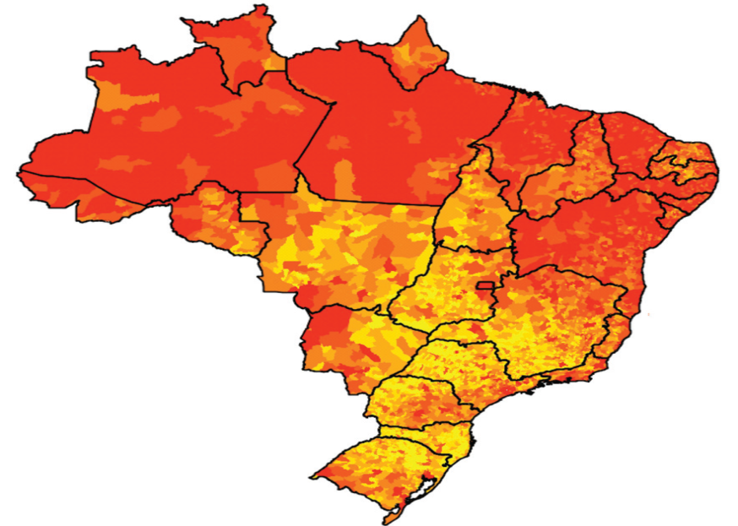
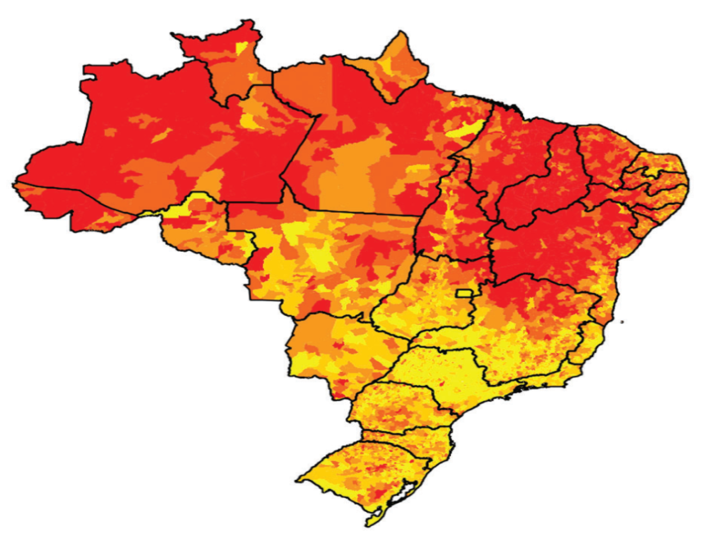
Brazil: reducing inequalities in income and in access to public services
Income inequalities
Insufficiency of public services
Brazil’s Zero Misery Plan
Challenges and opportunities for the implementation of adequate and proper policy for the promotion of LIPSs for sustainable development
20

Slide 20
Policies for innovation: how to advance
The adoption of policies - that favor the development of production and innovation capabilities related to expanding the provision and the quality of essential public services - can produce significant consequences:
contextualization, proper modernization and considerable expansion of the research and policy agendas
  sustainability and access to knowledge as main priorities in the Third Millennium, and relate to a logic compatible with cooperation and dissemination of experiences and capabilities
increase in the support of a vast array of LIPSs spread across the different parts of the world
promising results in reducing social and regional imbalances
potential to amplify and renovate prodution and innovation capabilities and systems
21

Slide 21
Conclusion
Opportunities (and urgent need) to choose and use concepts, indicators and policy models that:
  Recognize and mobilize local potentialities and capabilities particularly in the least developed areas
  Associate economic and social development
    breaking invisibilities and exclusions
    helping to cut down inequalities instead of reinforcing them
  Emphasize the capacity to acquire and use all sort of knowledge - formal, informal, traditional, scientific etc. - and of promoting their integration
  Are really capable of addressing and promoting cohesive and sustainable development within a contextualized and collective vision of future
22

Slide 22

Thank you!
hlastres@bndes.gov.br

Slide 23

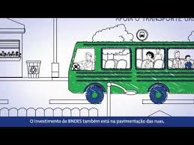




BNDES on Social Medias
YOUTUBE
www.youtube.com/bndesgovbr
SLIDESHARE
www.slideshare.net/bndes
TWITTER
twitter.com/bndes_imprensa
FACEBOOK
www.facebook.com/bndes.imprensa

