Slide 1
Agrarian transition, Transformative change and Systems of Innovation: Lessons for SDG Implementation
Dinesh Abrol, ISID
INDLIACS Conference
March 16, 2016

Slide 2
Introduction
Transition Perspective approaches
  Multi-level perspective,
  Strategic Niche Management
  Transition management
Innovation System: Failures and correctives
  Directionality
  Demand articulation
  Policy coordination
  Reflexivity
Politics of transformation
    Contestations on LPG for opening of spaces for SD
    Regulation
    Planning
    Social mobilization
    Participation
    Experiment
    Insertion of new social carriers of innovation

Slide 3
Innovation Systems and Transformative Change:
  One view supports regulation of restrictions on technological change and the other view questions the feasibility of labour intensive methods and consequences of support for a lower growth rate of labour productivity on wellbeing
  Need to abandon a naïve view of technological advance as a universal achievement; difference between scientific facts and technological artifacts; interpretive flexibility evident, scientific advancement increasing the number of alternatives
  Socially (politically) constructed contingent combinations, demand regulation & transformation (Water, soil, agrochemicals to agro-ecology) need to work on the construction of rationality of systems,
    products & processes defined as codes & standards, measures of productivity (primary / secondary), co-products & byproducts obtaining, energy efficiency, emissions, non-violation of nine planetary boundaries, recyclability, reuse, sustainability (social, health and environmental),
    Political control of technological change are a reality, innovation systems were not constructed in a politically neutral manner

Slide 4
Sustainable development:
What does it mean politically?
Social (political) rationale of building of worker-peasant alliance for the advancement of peoples’ democracies demands a re-evaluation of the treatment of question of organization of productive forces, relations of production and resource use in agriculture, industry, energy, automation, environment and so on.
Need to revisit the agenda for not only w r t identification of social protection related new set of immediate demands (such as income support) in the wake of the capitalist state embracing neo-liberalism but also w r t constitution of structures for the advancement of agrarian transformation and autonomous industrialization of the nation.
Following from the above comes the agenda of progressive mobilization on the question of technological alternatives and organizational forms in global south

Slide 5
Agrarian Question
Classical formulation of agrarian question considered worker-peasant alliance for :
  1) breaking land concentration,
  2) establishment of alternative path of peasant capitalism allowing a broad-based capitalist development and
  3) formation of collective property on the basis of egalitarian land ownership to enable an advance beyond bourgeois democratic revolution towards peoples’ democracy and socialism.
Emergence of corporate capital as a player and the state embracing neo-liberalism withdrawing from the role of supporting the peasantry and petty producers
  Understanding for example whether the cost for small and marginal farmers is higher now than before or not

Slide 6
New areas of transitional demands
Environment, Energy and Resource use
Degradation of eco-system functions can come from two major sources (C.H. Hanumantho Rao, 1988):
  first source: from deforestation and degradation of land on account of vegetative cover, resulting in low water table and loss of top soil which have a direct bearing on the productivity of soil, its vulnerability to rainfall variations, scarcities of drinking water, fodder and fuel wood causing hardships to the rural poor and
  Second source: from monocultures and the misapplication of yield increasing inputs like water, chemical fertilizers and pesticides, causing water logging and salinity and pollution of drinking water, loss of fish, etc.
Second source of ecological degradation considered unimportant w r t the treatment of the question of productive forces, relations in production and resource use in progressive social science discourse
  Social rationality not problematized from environment, health, nutrition
  Lessons from the experience of labour resistance (labour process debate of global south)

Slide 7
Not Anthropocene, But Capitlocene
Contradiction with big business and capitalist landlords accentuating due to consequences of mainstream pathways for maintenance and development of primary productivity and eco-system functions
Discourse on the irrationality of mainstream pathways of (e.g. high external input system of agriculture- agro-chemical, GM, monocultures, RETs / fossil fuel use, diseconomies w r t automobile & logistics, ecological degradation / climate change and deskilling
Question of alternatives to capitalist treatment of eco-system degradation, productive forces, relations of production & resource use following from the tendencies of cheap nature and unpaid labour is still not central or in focus
Need of correctives and the question of agenda of the labour’s agrarian question in temperate lands

Slide 8
New Transitional demands
  1) resisting withdrawal of the state from the role of supporting the peasantry and petty producers,
  2) struggle against primitive accumulation of capital leading to the dispossession of peasantry and ensuring that land acquisition takes place in conformity with social rationality,
  3) struggle against corporate and contract farming practices
  4) preventing peasantry from making a shift to socially irrational technological and organizational changes and cropping systems which endanger food security and
  5) promoting the implementation of MGNREGS by forming trade unions and uniting people against the privatization of education and health.

Slide 9
New Areas of Transitional Demands
Demands framed in respect of land relations and use, support restoration for agriculture (income support, price control, input subsidy, public procurement), debt relief, income assurance
Demands focus on relief & survival which are in long run in conflict with the achievement of goals of economic, social and ecological justice
Agro-ecological approaches are better placed to resolve this conflict; social carriers and eco-system for a new socio-technical regime need to be created
Social movements & researchers need to debate and deliberate on alternatives to dominant perspective emerging on the technology question.

Slide 10
Agro-ecology
Towards an alternate pathway
Struggles emerging for the realization of ecological justice allow an alignment of peasant rationality with socially rational technologically and organizational changes.
Environmental problems offer an important opportunity and can help create a new track of mobilisation of peasantry, artisans and rural labour against big business and capitalist landlords.
Pathways that embrace ecological agriculture friendly socio-technical systems to permit new relations in resource use, technology choices, the use and structuring of labour power and their relationship with the state.
Spaces for the construction of all-in-peasant unity, unity of petty commodity producers from both farm and non-farm sectors and the leadership of working class including rural labour can be realized far more rapidly.

Slide 11
Sustainability, Technology and Capital
Technology in the seed, modern plant breeding & GMs deliver solutions to hunger which get rolled out at scale
Seed companies, international & national agricultural research bodies, plant breeders & biotechnologists, funding organizations are still wedded to dominant perspective
Increases in crop productivity at the field and crop level extrapolated as a gain of food security, system change framed in terms of investment in technology, supply chain, credit, management, etc.
Skewed funding of public research, disciplines, hierarchies, priorities, IP based incentives, PPPs, corporate agriculture
Crisis continues, food availability, livelihood insecurity, worsening of ecological health, public health, etc.

Slide 12
Agriculture: Experiments, Niches and Regime
Natural Farming / Traditional Farming; Organic farming (input change); Agro-ecological approaches promoting Integrated and diversified farming systems
    Search for technological alternative at the farm level
    Eco-system level planning, organization of neighbourhood user communities for equitable access, socially rational resource use and recovery of commons- land, grazing areas, wetlands, forest and water sources
    Experiments for transformation of socio-technical regime change at the level of state policy and programme
      NPM, Organic Agriculture
      Restoration of paddy
      Water management
      Animal husbandry
      Forest Rights

Slide 13
Technological Modernization: Indian Journey
  Mainstream conception of technological modernization providing competition to the conceptions of residual pathways,
  Gains of pre & post-liberalization catch up strategy do not accrue to the poor; mainstream technological modernization had a bias; growth not upgrading local economies ; growing dependence on trickle down in neo-liberal regime (130-300 yrs)
  considering large scale technological systems to be superior for all activities & practicing value-neutral S&T development under the hegemony of a universal worldview of progress
  Outcomes of pro-poor innovation-making pathways also determined by the challenge to mainstream from the other three residual frames of socio-technical modernization
  Frame I (KVIC, Gandhian and Neo-Gandhian Tradition )
  Frame II ( CSIR & Nehruvian Imagination)
  Frame III (PSM )
Notes:
Supported the knowledge institutions to focus on public goods & poor and also achieve rapidly technological self-reliance for the promotion of domestic industries based on indigenous raw materials and their processing, infrastructure (dams, power, railways), capital goods, etc. For poverty reduction discouraged luxury consumption and struggled for land distribution, irrigation for improved productivity, protection via extension of credit and market support, employment generation, livelihood protection, creation of domestic demand.

Slide 14
Non-mainstream pathways
Framings
Frame I (KVIC, Gandhian and Neo-Gandhian Tradition )
  Upsizing / modernizing indigenous technology and individual producer to be made competitive by upgrading the local / traditional technology (Frame used by appropriate / intermediate technology movement in based on the ideas of (Schumacher Gandhian tradition; Small is beautiful), indigenous / local knowledge, local raw materials, skills & capabilities; ) which sees holism in individual producer completing the production of product without any / minimum division of labour (KVIC)
Frame II ( CSIR & Nehruvian Imagination)
  Downsizing modern technology in order to make the technology appropriate for tiny / micro / small & medium enterprises & this frame of “appropriate” / “economical”/ “commercial” sizing & designing approach has been used by local ingenuity innovators / mainstream in S&T to accommodate the role of MSMEs in the economy(CSIR)
Frame III (PSM)
  Organizing the unorganized for cooperation in production, economies of scale & scope via technological upgrading of peasant-artisan economies as systems in itself for multi-sectoral network development

Slide 15
Transformation Challenge
Peasant-Artisan-Worker Relations in Multi-sectoral Economy
  Rudimentary networks exist for all
  Upgrading of peasant-artisan economy as system in itself
  S&T Field Groups and networks feasible for all
Examples of system design which reflect the rationality (techno-economic, environmental, resource use, market development, capabilities development, political & social control)
Leather & full carcass utilization
Black mithy & carpentry; construction technology and materials, pottery, reed/bamboo works.
Animal husbandry & dairy products
Horticulture Products:- Processing & preservation
Plant based health systems
Aquaculture (fresh/coastal)
Economic plants processing
Land, water & cover including nursery & seed selection to fulfill needs of above sections (integrated)

Slide 16
Labour and Rural Industrialization:
Need for a transformative strategy
distributed, networked rural enterprises
systemically integrated/ localized/decentralized production and distribution systems
adding value to rural plant/animal/mineral resources for finished/semi-processed products
local/regional markets or intermediates
create rural jobs, improve rural incomes, improve rural-urban terms of trade
save transport energy, reduce urbanization
Antidote of neo-liberal globalization: low entropy system

Slide 17
Worker-Peasant Alliance, Collective Property and Group Enterprise
Organizing the unorganized for cooperation in production
Experiments in the construction of rural non-farm systems in fruits & vegetable processing, millets processing, oilseeds processing, pulse milling, non-edible oilseeds utilization,
Socially rational mechanization, women organize for labour collectives and land leasing and green army.
Kudumbshree

Slide 18
Understanding systemic connections
Relations within sectors – between operations at different levels.
Relations between sectors
Relationship of engineering sector primary/secondary sectors
Relationship of multipurpose multi-species wood lots with secondary production.
Relationship between primary & secondary production
MESSAGE: Artisan based secondary production helps develop organization & scale of coverage.

Slide 19
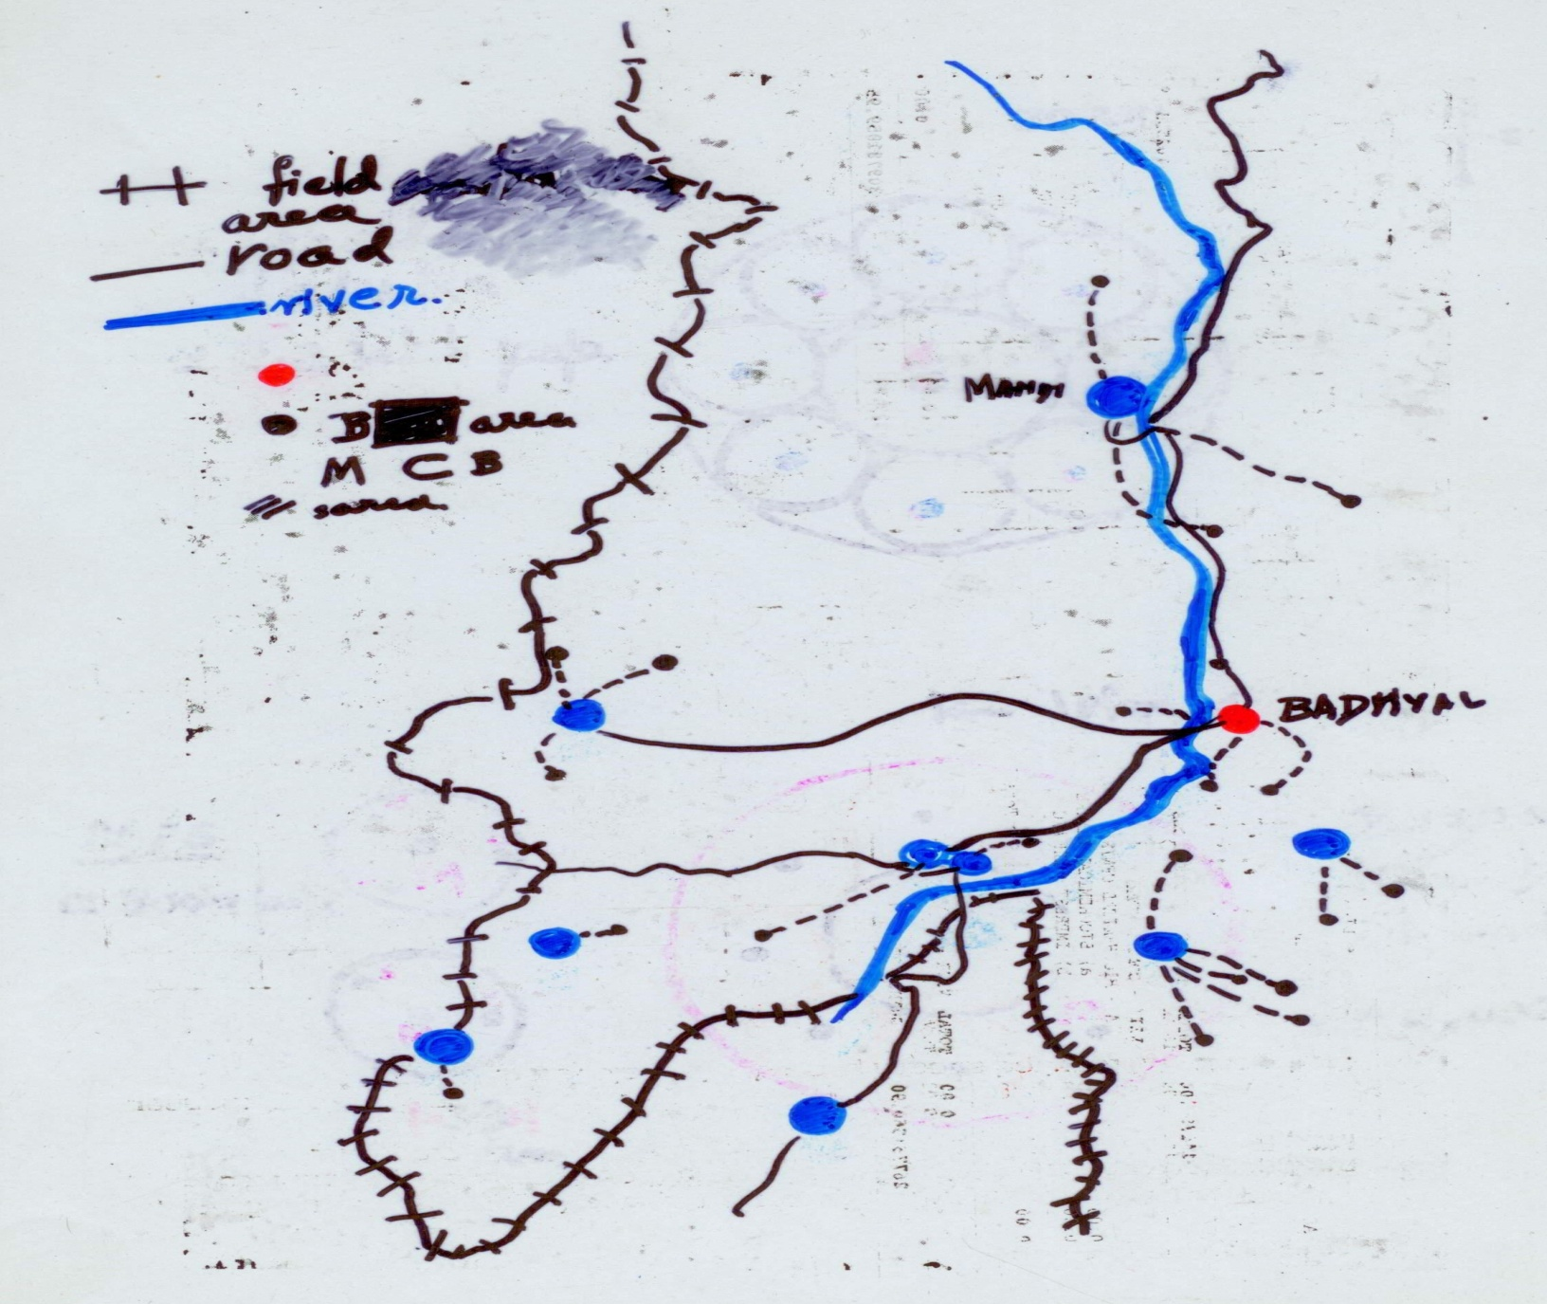
Map 1

Slide 20

Peasant-Artisan Economy & Networked Production System
B/M/S level- Units
R-M collection
primary processing
co--products
NODAL Unit
Finish-processing
by-products
Quality control
buy-back from S/V-Units
Marketing
further value-addition

Slide 21
System Design for Bullock Cart
N/B/M/S
Complete Bullock Carts Fabrication
B/M/S
Wheel Replacement Purchase
Beam Repair Replacement
Iron Tyre Fixing
Peasant User of Cart
Immediate Fixing
M/S
N
Village near Forest
Small Town
Carpenter, Blacksmith
@ N, or
@ Large, or Region Meals

Slide 22

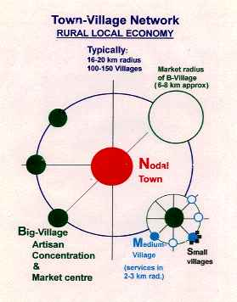
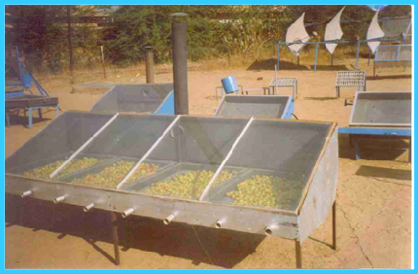
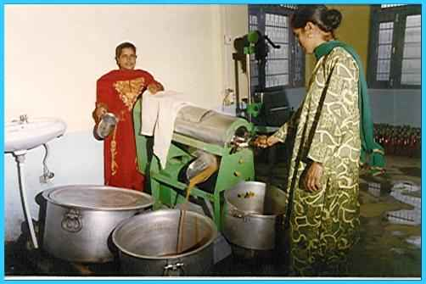
Horticulture/NTFP Processing
India is world’s largest producer of Fruits/Veg 65% by small farmers; but 25% wasted, only 3% processed
System Design
network of growers
cluster of 15-20 vill.
Nodal ‘mother’ Unit
+ vill. ‘satellite’ ops.
multi-product Unit
year-round ops.
FPO licensed
branded products
local/nearby markets
finished/semi-fin. for
bulk buyers
10 f-t, 40-50 seasonal
jobs mostly women
Over 40 Units set up all over India

Slide 23
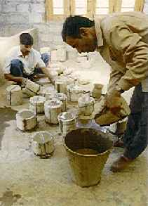
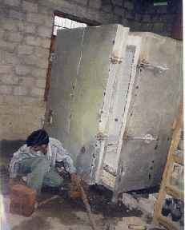
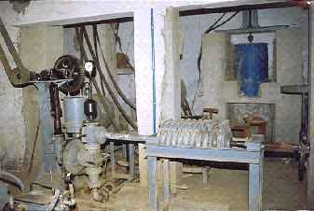
Red-Clay Pottery
400,000 Potters in India in near-terminal decline due to shrinking markets, rival materials, old techniques, limitations of red clay
CTD Technology Package
upgraded clay (1050 ° C)
  red-clay + admixtures
diversified product range
  table-ware, tiles...
‘new’ forming methods
  slip cast, press, jigger
equipment/machines
  pug mill, ball mill, kiln
CTD
LPG Kiln
Field Model
Unit for 6-10 Potters
satellite Units upto biscuit
local incl. tourist markets
Pilot
Plant

Slide 24
System Design & Development:
System of Production-Organisation of Multi-level Nodes
N Level: Marketing & Technology Incubation
B Level: Mini Dal Mill and One TPD Oil Units,
Tertiary Processing: Sattu, Besan etc.
M Level: Units for Pulse dehusking, Cattle feed & Seed production
M
M
M
S
S
S
S
S
S
S
S Level: Drying and Storage Units

Slide 25
Concluding Remarks
Resist through not only preventing and opposing but also by promoting alternatives for socio-ecological and socio-technical alternatives to change the relations in resource use and production
Landless and rural labour need to be prioritized in the regeneration of eco-systems and egalitarian ownership of land and other resources
Redefine contiguous area based worker-peasant organization for the construction of alternate pathways to bring back the question of advance towards a more democratic polity, peoples’ democracy and socialism
Promote democratization of knowledge production in social sciences, natural and technical sciences and technology generation.

