Slide 1
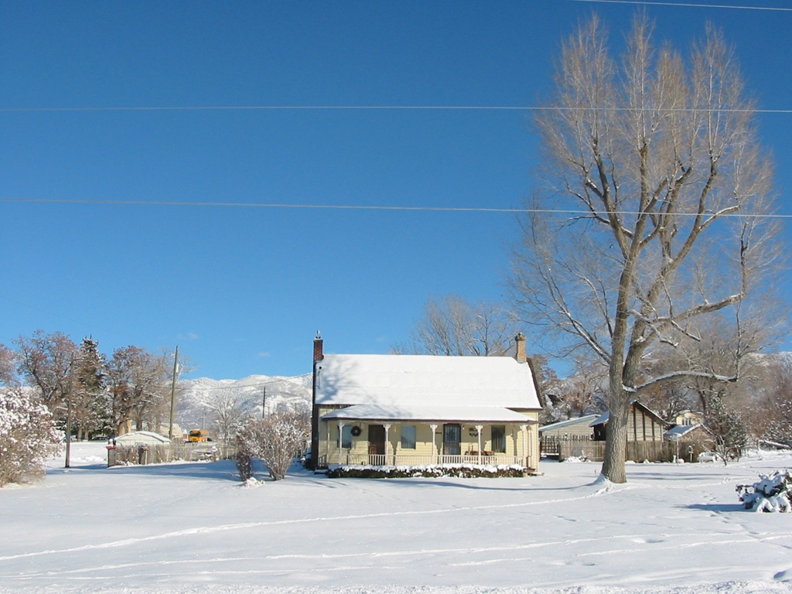
WELCOME

Slide 2
Inclusive Innovations in Plantation Agriculture
Dr. C.Bhaskaran

Slide 3
What is your innovative and honest opinion about the solution to shortage of food in the other parts of the world?

Slide 4
AGRICULTURAL RESEARCH ORGANISATION

Slide 5
NARS NATP NAIP

Slide 6

ICAR –SAUs-Commodity Boards-NGO-
Pvt Research Institutions

Slide 7

FPR – TAR – IVLP – PTD-FLTD

Slide 8
Farmer Innovations
“Njallani” cardamom
“Thekkan” pepper

Slide 9
EXTENSION ORGANISATION

Slide 10
ICAR-SAU-KVK-PILOT pjt
Front line Extension
I

Slide 11
Line Departments
Commodity Boards
Private-NGO Extension

Slide 12
GROUP APPROACHES

Slide 13
GROUP FARMING
GALASA
VFPCK
KUDUMBASHREE
SUBHIKSHA
SANGAMAITRI

Slide 14
RUBBER BOARD – 1957
1986- RPS-Society
2010- 2500 RPSs
1957 - Productivity-350 Kg/ha
2010 - Productivity-1879 Kg/ha

Slide 15
RPS TOT Centres Model RPS Companies Eco friendly Gp
Processing SHGs Estate Inputs
Value addition Apiculture
Carbon Credit

Slide 16
INNOVATIONS IN TECHNOLOGY DISSEMINATION

Slide 17
Innovation role of extension is to link the farmers with service providers

Slide 18
ATMA
LEADS
ATMA PLUS
EXTENSION PLUS-MIDICCI

Slide 19
M-Multi-dimensional
I -Intensification
D-Decentralisation
I -ICT-enabled
C-Convergence
C-Competence
I-Innovation-driven

Slide 20
FARMER EXTENSION ORGANISATION(FEO)
Federated structures of ATMA Groups at Blocks
Registered under Charitable Societies Act
TIES group – Training, Inputs,Extension,Services
Forward and Backward linkages
Reference group-centred learning
Staggered Govt.withdrawal

Slide 21
GOOD BYE EXTENSION;
HELLO INNOVATION ?
          EXTENSION=INCLUSIVE INNOVATION
          INNOVATE OR PERISH

Slide 22
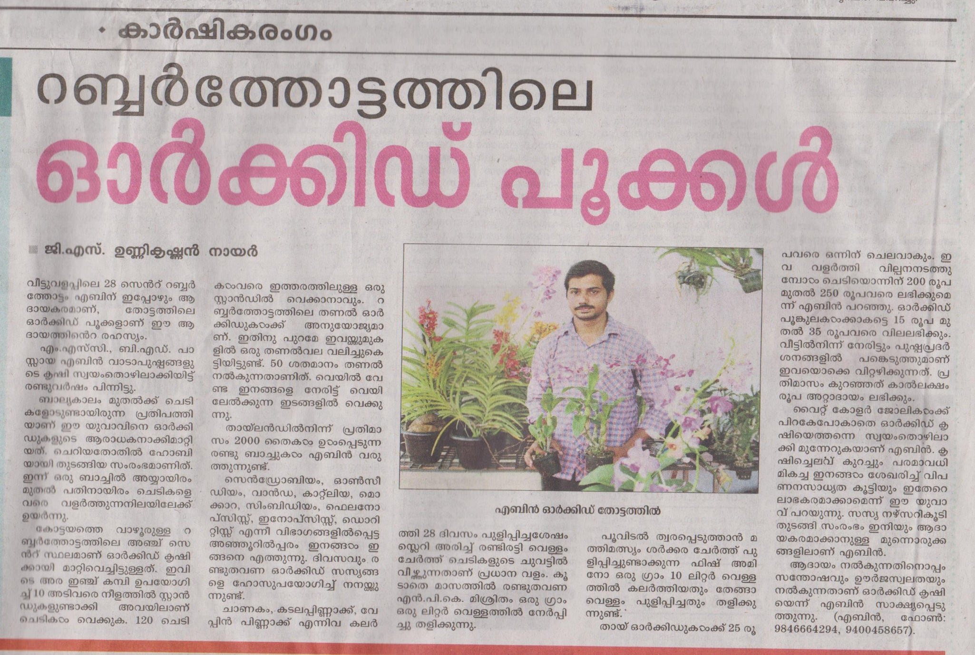

Slide 23
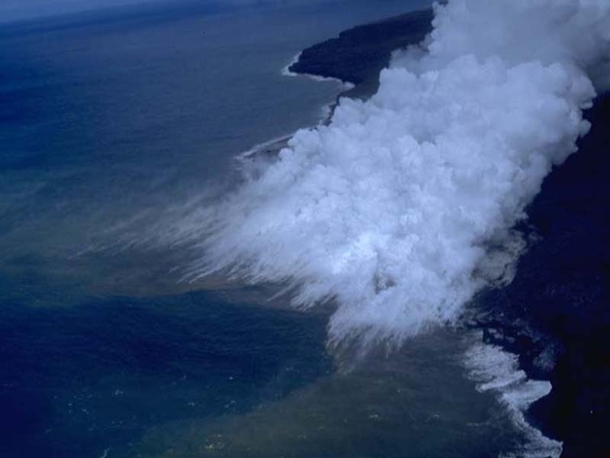
BOTTOM LINE
Sustainable development programs depend more on innovations, leadership and appropriate strategies than money.

Slide 24
Thank you

