Slide 1
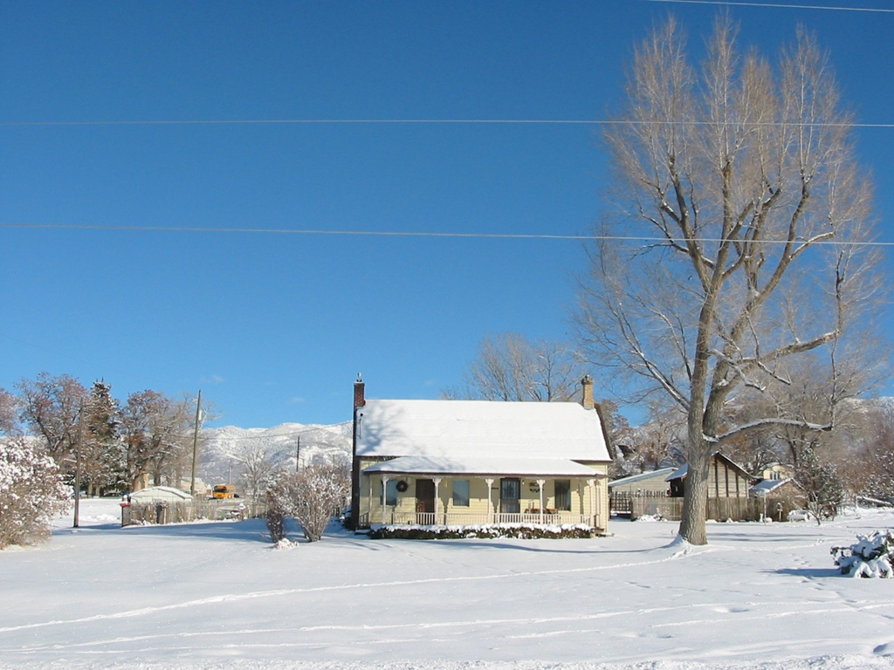
WELCOME

Slide 2
Inclusive Institutional Innovations in Agricultural Research and Extension
Dr. C.Bhaskaran

Slide 3
What is your innovative and honest opinion about the solution to shortage of food in the other parts of the world?

Slide 4
AGRICULTURAL RESEARCH ORGANISATION

Slide 5
NARS NATP NAIP

Slide 6

ICAR –SAUs-Commodity Boards-NGO-
Pvt Research Institutions

Slide 7

FPR – TAR – IVLP – PTD-FLTD

Slide 8
EXTENSION ORGANISATION

Slide 9
ICAR-SAU-KVK-PILOT pjt
Front line Extension
I

Slide 10
Line Departments
Commodity Boards
Private-NGO Extension

Slide 11
GROUP APPROACHES

Slide 12
GROUP FARMING
GALASA
VFPCK
KUDUMBASHREE
SUBHIKSHA
SANGAMAITRI

Slide 13
Rubber Plantation Development

Slide 14
RUBBER BOARD – 1957
1986- RPS-Society
2010- 2500 RPSs
1957 - Productivity-350 Kg/ha
2010 - Productivity-1879 Kg/ha

Slide 15
89 % area
92 % production Small Holdings < 0.50 ha

Slide 16
RPS TOT Centres Model RPS Companies Eco friendly Gp
Processing SHGs Estate Inputs
Value addition Apiculture
Carbon Credit

Slide 17
INNOVATIONS IN TECHNOLOGY DISSEMINATION

Slide 18
Innovation role of extension is to link the farmers with service providers

Slide 19
ATMA
LEADS
ATMA PLUS
EXTENSION PLUS-MIDICCI

Slide 20
M-Multi-dimensional
I -Intensification
D-Decentralisation
I -ICT-enabled
C-Convergence
C-Competence
I-Innovation-driven

Slide 21
FARMER EXTENSION ORGANISATION(FEO)
Federated structures of ATMA Groups at Blocks
Registered under Charitable Societies Act
TIES group – Training, Inputs,Extension,Services
Forward and Backward linkages
Reference group-centred learning
Staggered withdrawal

Slide 22
GOOD BYE EXTENSION;
HELLO INNOVATION ?
          EXTENSION=INCLUSIVE INNOVATION
          INNOVATE OR PERISH

Slide 23
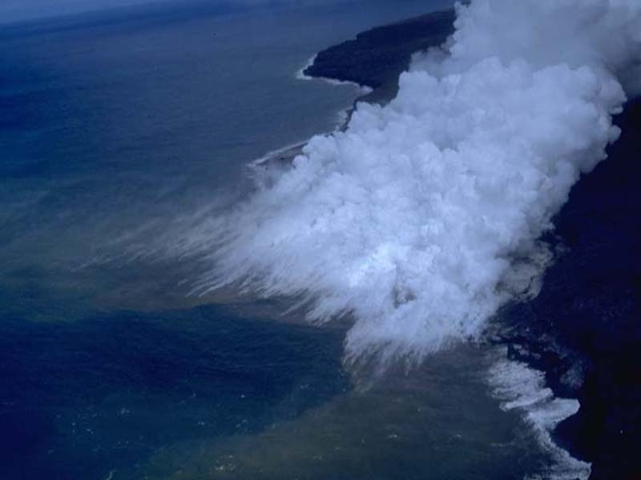
BOTTOM LINE
Successful extension programmes depend more on iinnovations, leadership and appropriate strategies than money.

Slide 24
Thank you

